Slide 1
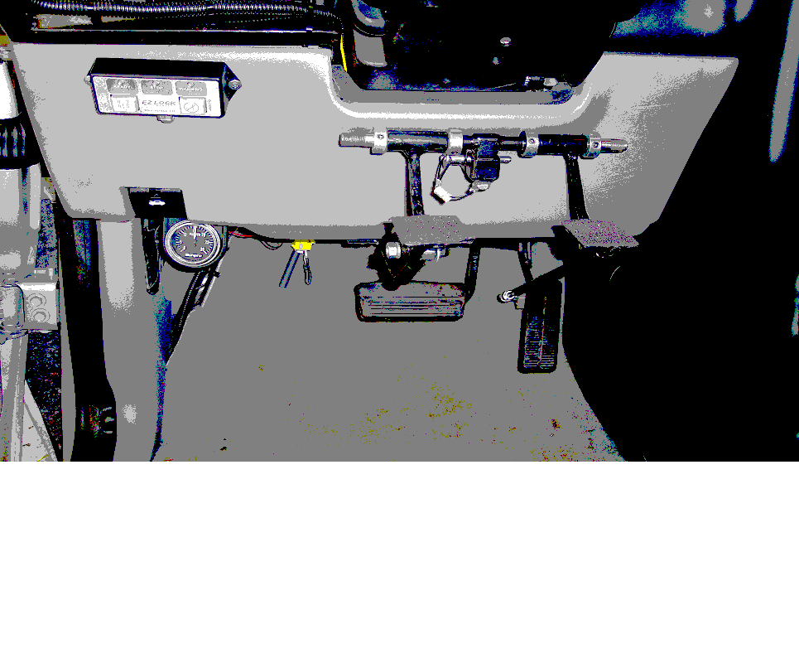
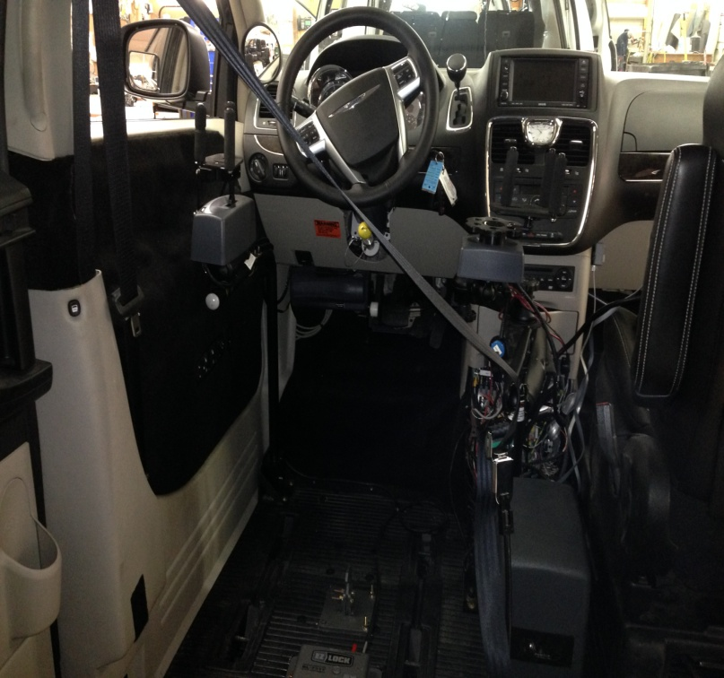
INTRODUCTION TO DRIVER REHABILITATION
Clinton Matney, CDRS
Vehicle Modification Specialist
KY Department Of Vocational Rehabilitation

Slide 2
Why Is There Such A Thing As Driver Rehabilitation/Evaluation?
Vehicle Design
The Legal Aspects of
Driving

Slide 3
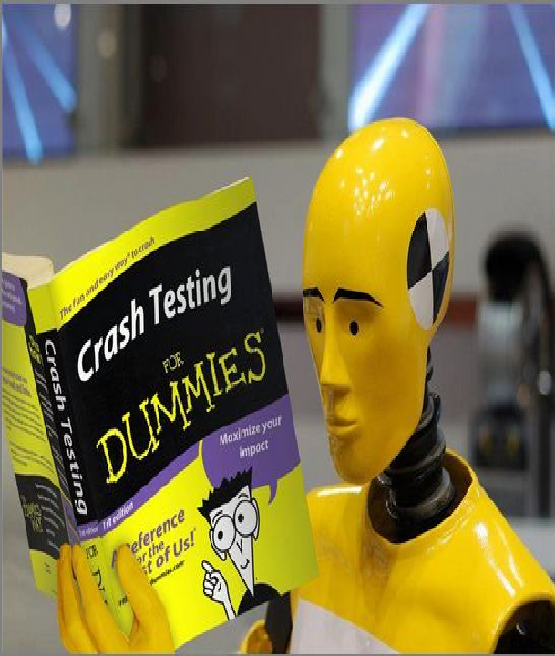
Vehicle Design
With few exceptions vehicles are designed around the able body 50th percentile group male. (5'9") (170 lb). A dummy of these proportions occupies the driver's seat in all the Insurance Institute for Highway Safety (IIHS), 40 mph offset frontal crash tests.

Slide 4
LAWS AND REGULATION
The Component’s Of Driving Are All Regulated
The Vehicle
The Environment (Roadways, Traffic)
The Driver

Slide 5
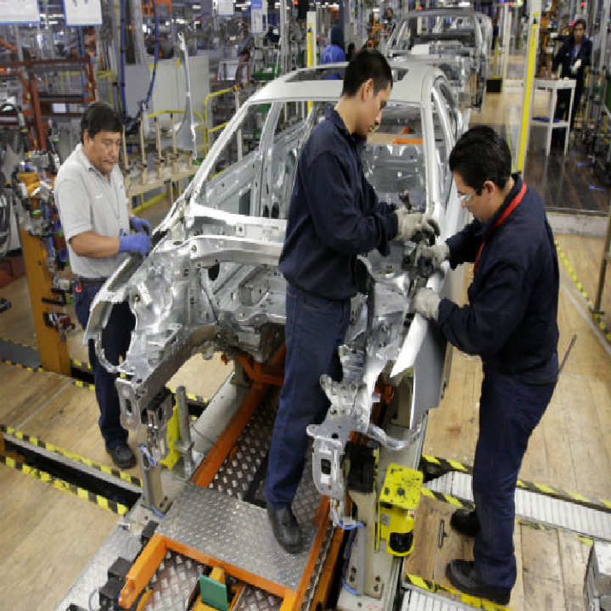
LAWS AND REGULATION
The
Vehicle
Federal Motor Vehicle Safety Standards
Standards for commercially sold motor vehicles and motor vehicle equipment established under
section 103 of the National Traffic and Motor Vehicle Safety Act of 1966. Title 49 CFR 571
Title 49 U.S.C. 30122 Making safety devices and elements inoperative
(a) Definition. - In this section, "motor vehicle repair business" means a person holding itself out to
the public to repair for compensation a motor vehicle or motor vehicle equipment. (b) Prohibition. –
A manufacturer, distributor, dealer, or motor vehicle repair business may not knowingly make
inoperative any part of a device or element of design installed on or in a motor vehicle or motor
vehicle equipment in compliance with an applicable motor vehicle safety standard prescribed under
this chapter unless the manufacturer, distributor, dealer, or repair business reasonably believes the
vehicle or equipment will not be used (except for testing or a similar purpose during maintenance or
repair) when the device or element is inoperative.

Slide 6
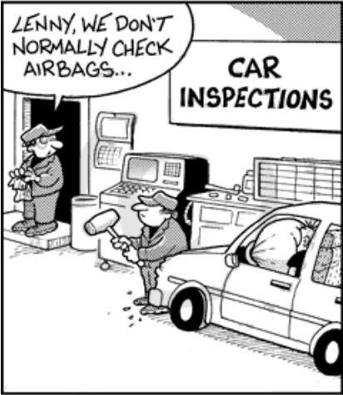
LAWS AND REGULATION
The
Vehicle
(Cont’)
Federal Motor Vehicle Safety Standards
Title 49 CFR 595 Exemptions to The make inoperative prohibition
The purpose of this part is to provide an exemption from the “make inoperative” provision of 49
U.S.C. 30122 that permits motor vehicle dealers and motor vehicle repair businesses to install
retrofit air bag on-off switches and to otherwise modify motor vehicles to enable people with
disabilities to operate or ride as a passenger in a motor vehicle.

Slide 7
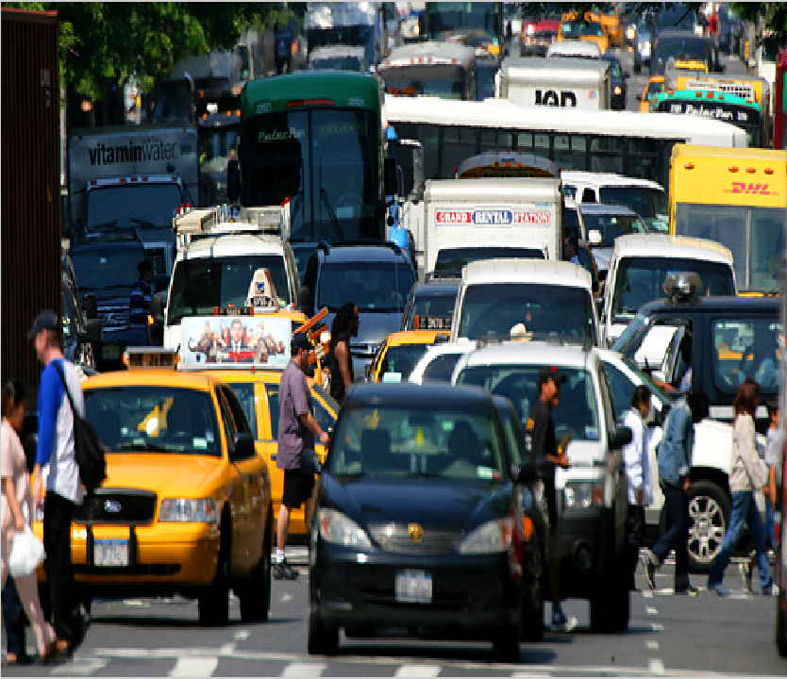
LAWS AND REGULATION
The
Environment
Traffic Laws And Control Devices
Although each state has it’s own traffic code, most states have adopted relevant standards
for signs and signals, based upon the Manual on Uniform Traffic Control Devices from
the U.S. Department of Transportation. Similarly most states have adopted the traffic laws,
and road design from the Uniform Vehicle Code. In any event a driver is obligated to follow
the prevailing laws and traffic controls or risk fines and/or revocation of driving privilege.

Slide 8
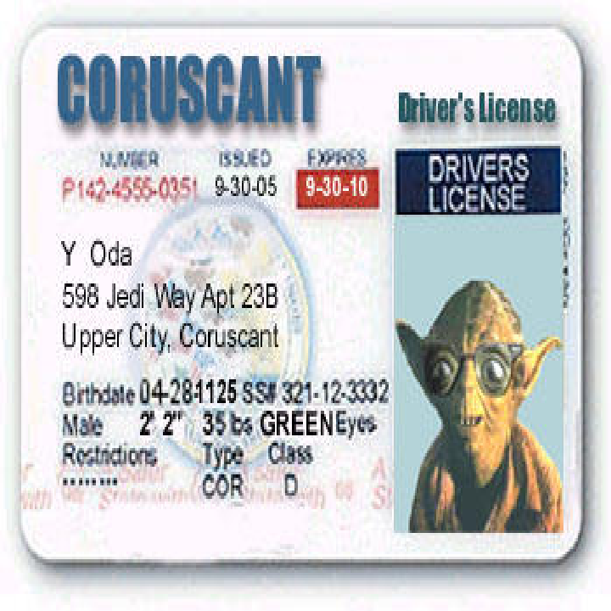
LAWS AND REGULATION
The
Driver
Driving is a privilege not a right
States can and do set application requirements such as age ,vision, etc,… Additionally states set
performance criteria and demonstration of same prior to issuing a license. States also place certain
conditional restrictions on a license such as corrective lenses, vehicle type, vehicle equipment,
day/night driving, and so on.
KENTUCKY: A Medical Review Board is administered through the Transportation Cabinet. Its
purpose is to provide the administrator with sound medical advice concerning the licensing of
individuals with physical or mental impairments. Any driver with a medically-diagnosable
impairment who does not possess the minimum physical or mental abilities to safely operate a
vehicle under all conditions will have his driving activities curtailed accordingly. Physically or mentally
impaired drivers are brought to the attention of the division by reports received from law
enforcement agencies, courts, or interested individuals having personal, detailed knowledge of the
impairment. In the event a report is accepted under the above criterion, the licensee will be required
to forward a completed medical questionnaire to the Division of Driver Licensing. The medical report
will be submitted to a review board consisting of appointed medical specialists. The board will study
the report and, based on their medical expertise, recommend restrictions.

Slide 9
DRIVER REHABILITATION PROCESS
COMPONENTS
Evaluation
Assessment of an individuals cognitive and physical abilities for
safe operation of a motor vehicle on public roadways.
Training
Equipment operation; Compensatory strategies; Tactical
Driving/Risk Management; Extended evaluation
Vehicle Modification
When indicated by evaluation and training, alteration of an
existing motor vehicle to accommodate an individual need that
allows the individual to safely and independently operate a motor
vehicle.

Slide 10
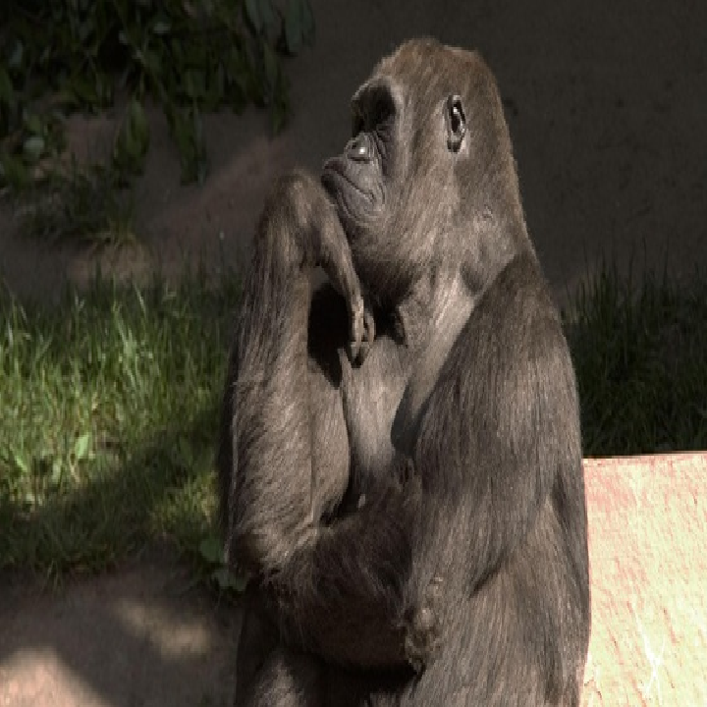
What Does a Driver Evaluation Consist Of ?
Interview/Physical Evaluation
Clinical Evaluation
On the Road Evaluation

Slide 11
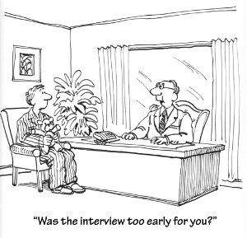

Interview And Physical Evaluation
Client Interview
  Diagnosis
  Social History
  Pertinent Medical History, including Hx of seizures
  Medications
  Driving History
  Permit/license information
Physical Evaluation
  Range Of Motion
  Strength
  Sensation
  Coordination
  Balance
  Tone
  Transfer
  Ambulation

Slide 12
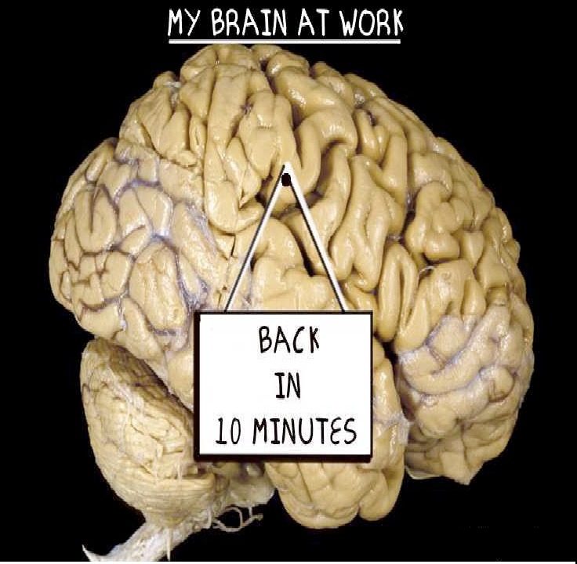
Mental Skills are Most Important
There are at least five mental subtasks to driving:
Understanding the motor vehicle
Perception based on stored knowledge
Understanding traffic laws
Judging time/space relationships
Concentration on task

Slide 13
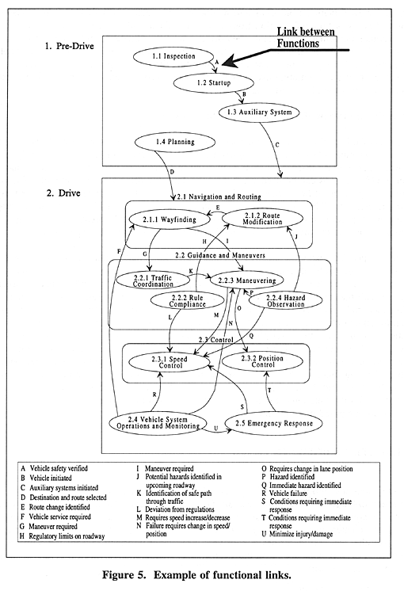
IT’S COMPLICATED
Notes:
Linking Groups of Tasks
In summarizing the detailed task descriptions with driving functions, figure 5 shows the links between driving functions. These links, drawn as arcs on the figure, reveal sequential dependencies and interactions between functions. Similarly, the arcs connecting driving functions represent triggering conditions that initiate functions and their respective tasks. For example, "vehicle safety verified" designates the arc labeled "A," which connects Inspection with Startup, and shows that Startup occurs only after the vehicle has been inspected and its condition verified. Other functions may require several triggering events to initiate the underlying tasks. For example, Maneuvering depends on Traffic Coordination and Wayfinding. Thus, the arcs serve two purposes. First, they show the sequential dependencies between tasks and functions. Second, the arcs show how changes in system state and information flow link driving functions. These links become particularly useful when examining how drivers act on information in the context of the other driving tasks because they show how information initiates and changes driver behavior. This becomes particularly important when drivers must coordinate regulatory traffic controls with environmental constraints, such as traffic conditions and roadway configurations. In general, the driving functions and the arcs that link them provide a summary of the information flows and initiating events that link general driving functions that might be lost in a more detailed view of individual driving tasks.

Slide 14
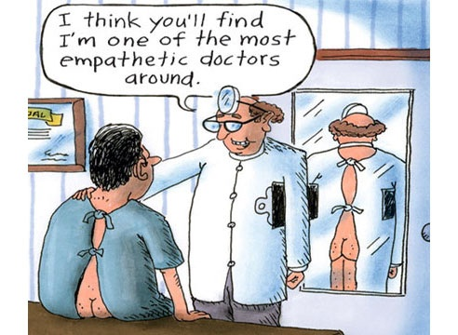
Clinical Evaluation
Vision (Biopter)
A stereoscope device for viewing a stereoscopic pair of separate images,
depicting left-eye and right-eye views of the same scene, as a single three
dimensional image. Tests Acuity; Color discrimination; Lateral and vertical
phoria; Depth perception.
Visual Perception (MVPT Motor Free Visual Perception Test)
Matching/identifying shapes and symbols testing how well you understand what your eyes
are seeing, and how long it takes to react or respond. Tests Spatial relations; Figure
Ground; Visual Discrimination; Visual Closure; Visual Memory
Cognition (Trails A and B)
Neuropsychological test consisting of connecting a set of 25 dots as fast as possible while
still maintaining accuracy. Tests visual attention; task switching; visual search
speed/scanning; processing speed; mental flexibility; executive function.

Slide 15
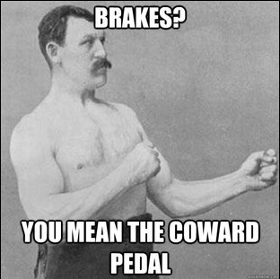
ON ROAD EVALUATION
Equip vehicle ‘when’ indicated by the
clinical presentation of the client.
Equip vehicle ‘as’ indicated by the
clinical presentation of the client.
Choose equipment that both matches
client’s functional ability and maintains
OEM characteristic’s as closely as
possible.

Slide 16
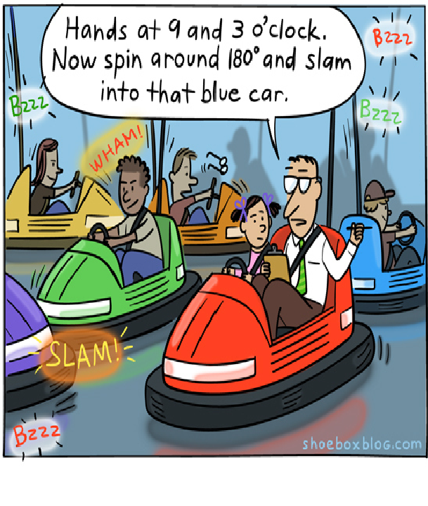
ON ROAD EVALUATION
Evaluation of
  Basic vehicle control
  Balance and coordination
  Overall driving skills and habits
  Awareness and response to environmental
  details and potential hazards
  Judgment of vehicle boundaries..space
  management
  Operation/orientation to adaptive
  equipment if needed
  Use of secondary controls and mirrors
Driving problems or behaviors will vary according to disability, diagnosis, driving experience, age, etc

